Slide 1
Data Preprocessing
Preprocess that data…whatever that means

Slide 2
Data Quality: Why Preprocess?
Data != Knowledge
  Knowledge acquisition is heavily dependent on data quality
There are several measures for data quality:
  Accuracy: correct or wrong, accurate or inaccurate, …
  Completeness: not recorded, unavailable, …
  Consistency: some modified but some not, dangling, …
  Timeliness: timely updates?
  Believability: how trustable the data are correct?
  Interpretability: how easily the data can be understood?

Slide 3

What is Preprocessing?
Preprocessing is the process of transforming the raw data in a useful and efficient format
  We want our data to be free from noisy and/or missing data as well as remove discrepancies

Slide 4
Is Preprocessing Important?
Yes
Not only is it necessary to perform meaningful analysis, but it will also take up the largest chunk of a data scientist’s time
  We’ve seen how quickly Python can perform the analytics components; ensuring the data is cleansed will require more from you: the analyst
It’s a safe assumption that data loading / preprocessing will take around 30-40% of your time on an analytics project

Slide 5
Forms of Data Preprocessing
Data cleaning
  Fill in missing values, smooth noisy data, identify or remove outliers, and resolve inconsistencies
Data integration
  Integration of multiple databases, data cubes, files, etc.
Data reduction
  Dimensionality & numerosity reduction,
  Data compression
Data transformation & discretization
  Normalization
  Concept hierarchy generation

Slide 6
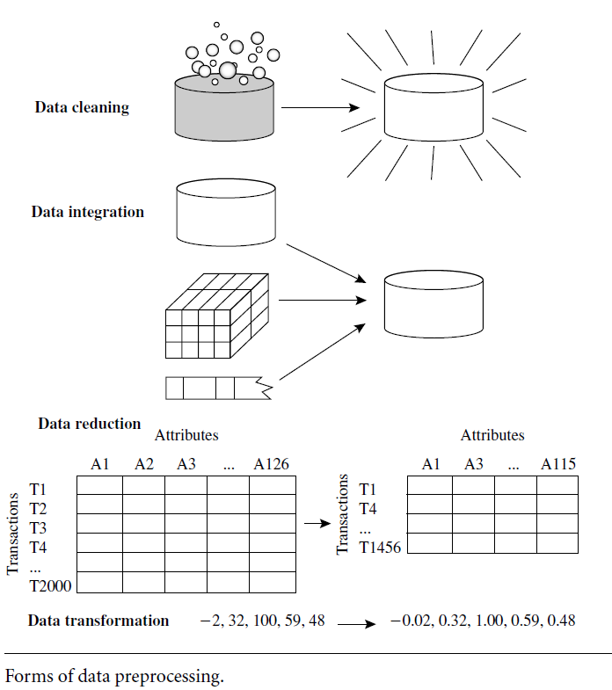
Forms of Data Preprocessing, cont.
Data Mining concepts and Techniques 3rd ed.

Slide 7
Data Cleaning
Scrub-a-dub-dub

Slide 8
Data Cleaning
Data in the real world is often dirty – there are a lot of potentially incorrect data in each data set
  Incomplete: lacking attribute values, lacking certain attributes of interest, only containing aggregate data
    E.g., Age = “N/A” (placeholders such as “N/A” can still be interpreted as missing)
    E.g., Salary = NaN or NULL (no value present)
  Noisy: containing “noise” (errors)
    E.g., Salary = -10 (an error)
  Inconsistent: containing discrepancies in codes or names
    E.g., Age = “52”, Age = “fifty-two”
    E.g., Gender = “M”, Gender = “Male”
    E.g., Rating = “A” on older records, but Rating = “1” in newer records
  Outliers
    1, 2, 700000000, 4, 2, 5

Slide 9
Practice Time!
Name | ID | Age | Salary | Income | Income Tax (5% of income) | Sex
Jake | 1 | 25 | 70 000 | 70 000 | 5 | Male
Mary | 2 | 28 | 90 000 | 90 000 | 4 500
Penny | 3 | 30 | 1 100 | 1 100 | 55 | F
Mark | 4 | 31 | 110 000 | 110 000 | 5 500 | Male
Ralph | 5 | -26 | 80 000 | 80 000 | 4 000 | Male
Mike | 6 | NA | 76 000 | 76 000 | 3 800 | M
Lena | 7 | 42 | 510 000 | 510 000 | 25 500 | Female
Nancy | 8 | 19 | 65 000 | 65 000 | 3 250 | Female
Sheldon | 9 | 0 | 95 000 | 95 000 | 750
See #1 on the worksheet ☺

Slide 10
How to Handle Missing Data
Ignore the rows with missing data (empty fields), or
Perform imputation
  Imputation is the process of replacing missing data with substituted values
  These values are either calculated (e.g., the mean of other records) or inferred (based on similar rows)

Slide 11
How to Handle Missing Data, cont.
Ignore the rows – this is not effective when the percentage of missing values per attribute is high (e.g., 50-60%)
Fill in the missing values manually: this is tedious if not outright unfeasible.
Fill it in with imputation
  The attribute mean: e.g., a missing value for “age” will take the mean of the “age” column
  The most probably value: this is inference-based with techniques such as kNN, Bayesian formulae, or decision trees (more later in the course)

Slide 12
Noisy Data
Noise is a random error or variance in a measured variable
Incorrect attribute values may be due to
  Faulty data collection
  Faulty data entry
  Data transmission problems
  Technology limitations
  Naming inconsistencies
Other data problems which require cleaning
  Duplicate records
  Incomplete data
  Inconsistent data

Slide 13
How to Handle Noisy Data
Binning: first sort data and partition into (equal-frequency) bins
  You can then smooth (reduce noise) by bin means or bin medians
Regression: smooth by fitting the data into regression functions
Clustering: detect and remove outliers
Combined computer and human inspection
  Detect suspicious values and check by human
    E.g., looking over possible outliers: if a value in the Age column is 780 that is either noise or an immortal

Slide 14
Detecting Discrepancies
Use metadata (e.g., domain, range, dependency, distribution)
Check field overloading
Check uniqueness, null, and other constraints
Use tools such as commercial products or AI:
  Data Scrubbing: uses simple domain knowledge (e.g., postal codes, spell-checking, etc.) to detect errors and make corrections
  Data auditing: analyze data to discover rules and relationships to detect violators (e.g., correlation and clustering to find outliers)

Slide 15
Data Integration
Integwation

Slide 16
Data Migration & Integration Considerations
Data migration tools allow transformations to be specified
ETL (Extract/Transform/Load) tools allow users to specify transformations through a GUI
  E.g., Microsoft SSIS with MS SQL Server

Slide 17
Data Integration
Data integration: combining data from multiple sources into a coherent dataset.
Entity identification problem:
  Identify real world entities from multiple data sources: e.g., “Robert Jones” = “Bob Jones”, “n00b” = “newbie”, “Santa Claus” = “Saint Nick”
Detecting and resolving data value conflicts:
  Possible reasons: different representations, different scales (e.g., kilogram vs. pound, kilometer vs. mile, etc.)

Slide 18
Handling Redundancy in Integration
Redundant data occur when sourcing data from multiple sources
  Object identification: the same attribute or object may have different names in different databases
  Derivable data: one attribute may be a “derived” attribute in another table: e.g., the dollar-amount of your salary withheld for retirement
Redundant attributes may be able to be detected by correlation analysis and covariance analysis
Careful integration of data from multiple sources can help reduce/avoid redundancies and inconsistencies and improve mining speed and quality.

Slide 19
Data Reduction
GET RID OF IT ALL (well, not all)

Slide 20
Data Reduction
Data reduction: obtaining a reduced representation of the data set that is much smaller in volume yet produces the same (or almost the same) analytical results.
Why?
  Databases/data warehouses may store terabytes of data or more. Complex analysis could take an extremely long time to run on the entire data set.

Slide 21
Reduction Strategies
Dimensionality Reduction
  Removing unimportant attributes
    Principal Components Analysis (PCA) – later in the course
    Feature subset selection, feature creation
Numerosity Reduction
  Removing the number of records across all attributes
    Regression – later in the course
    Histograms, clustering, sampling – later in the course

Slide 22
Dimensionality Reduction
Curse of Dimensionality
  When dimensionality increases, data becomes more sparse
  Density and distance between points becomes less meaningful
    This is detrimental to clustering and outlier analysis
  The possible combinations of subspaces will grow exponentially
Dimensionality reduction
  Avoids the curse
  Helps eliminate irrelevant features and reduce noise
  Reduce time and space required in mining
  Allows for easier visualization

Slide 23
How to Reduce Dimensions
An easy way to reduce dimensions is by being selective of attribute subsets.
Redundant attributes: duplicates of much or all of the information contained in one or more attributes
  E.g., purchase price, sale price, and sales tax – purchase price is redundant
Irrelevant attributes: contain no information that is useful for the mining task at hand
  E.g., student E-Numbers are irrelevant when predicting average GPAs for a course

Slide 24
Data Transformation
Decepticons – lock in

Slide 25
Data Transformation
A function maps the entire set of values of a given attribute to a new set of replacement values so that each old value can be identified with one of the new values.
There are two methods to do this:
  Normalization: scaled to fall within a smaller, specified range
  Discretization: binning, concept hierarchy climbing

Slide 26
Normalization
Measurement units can affect data analysis
  Changing meters → inches may lead to different results
We can normalize/standardize data to avoid dependance on the choice of measurement unites
This process involves transforming the data to fall within a smaller or common range such as [-1, 1] or [0.0, 1.0]

Slide 27
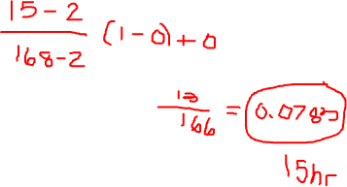
Normalization – Min-Max
Min-max normalization: to [new_min_{A}, new_max_{A}]
E.g., let income range be $12,000 to $98,000 normalized to [0.0, 1.0]. A salary of $73,600 can be mapped to

Slide 28
The End
Thanks ☺

